Slide 1
Publication Bias: Causes, Detection, and Remediation
Sven Kepes and Michael A. McDaniel
Virginia Commonwealth University
AOM PDW August 2, 2014
Philadelphia, PA
http://tinyurl.com/nfayr3r

Slide 2
Overview
Introduce publication bias analyses as a form of sensitivity analysis in meta-analysis.
Briefly review a few non-publication bias approaches to sensitivity analysis.
Focus on publication bias as a sensitivity analysis:
Causes of publication bias
Overview of methods for detection and assessment

Slide 3
Sensitivity Analysis

Slide 4
Sensitivity Analysis
A sensitivity analysis examines the extent to which results and conclusions are altered as a result of changes in the data or analysis approach (Greenhouse & Iyengar, 2009).
If the conclusions do not change as a result of the sensitivity analysis, one can state that the conclusions are robust and one can have greater confidence in the conclusions.

Slide 5
Sensitivity Analysis
Sensitivity analyses are rarely conducted in meta-analyses in the organizational sciences (Kepes, McDaniel, Brannick, & Banks, 2013).
Because meta-analyses have a strong impact on our literatures, sensitivity analyses need to become much more common (and reported) in meta-analyses.

Slide 6
Sensitivity Analysis: Outliers
One form of sensitivity analysis is to conduct meta-analyses with and without outliers.
Only 3% of meta-analyses conduct outlier analyses (Aguinis et al., 2011).
Effect size outlier (large or small)
Graphical methods and statistical tests for outliers (e.g., SAMD statistic; Beal, Corey, & Dunlap, 2002)
Sample size outlier (large)
Sample sizes influence effect size weights in meta-analyses.

Slide 7
Sensitivity Analysis: Outliers
One sample removed analysis:
Repeat the meta-analysis multiple times, each time leaving out one sample.
This yields as many means as samples. Examine the means.
How much does the distribution mean change when a given sample is excluded from the analysis?
Are the results due to a small number of influential samples?

Slide 8
Sensitivity Analysis: Operational definitions
Measures of a given construct often vary within a literature area/meta-analysis.
Beauty might be measured by:
Self-reports, observations of others, facial or body symmetry, etc.
The magnitude of effects may co-vary with the operational definitions of variables.
Are the results due to a specific operational definition/measure?

Slide 9
Sensitivity Analysis: Data imputations
Typically, one does not include a sample in a meta-analysis if the sample size and effect size are not known with certainty.
However, meta-analyses that involve corrections for artifacts (i.e., measurement error or range restriction) often need to impute at least some of the artifacts for some of the samples.

Slide 10
Sensitivity Analysis: Data imputations
Consider various imputed values.
After one identifies what one believes are the best imputations, create sets of artifacts that have higher values, sets with lower values, and sets with more or less variance.
How robust are the conclusions to varying assumptions about the mean and variability of the imputed artifacts?

Slide 11
Sensitivity Analysis: Publication bias
Publication bias analyses are a type of sensitivity analysis.
Publication bias exists when the research available to the reviewer on a topic is unrepresentative of all the literature on the topic (Rothstein et al., 2005).

Slide 12
Sensitivity Analysis: Publication bias
Only between 3% (Aguinis et al., 2011) and 30% (Kepes et al., 2012) of meta-analyses conduct publication bias analyses (typically with inappropriate methods; Banks et al., 2012; Kepes et al., 2012).
Similar terms/phenomena:
Availability bias, dissemination bias
Not necessarily about published vs not published

Slide 13
Sensitivity Analysis: Publication bias
Publication bias can distort a literature.
A meta-analysis of a literature distorted by publication bias will yield incorrect results.
Perhaps just a little incorrect
Perhaps substantially incorrect
One does not know the magnitude of the problem unless one assesses the potential presence of publication bias.

Slide 14
Sensitivity Analysis: Publication bias
Taxonomy of causes of publication bias (Banks & McDaniel, 2011; Kepes et al. 2012)
Outcome-level causes
Sample-level causes

Slide 15
Outcome-level publication bias refers to selective reporting of results (i.e., selective reporting of effect sizes). In other words, the primary study is available but some results are not reported.
Outcome-level Publication Bias in Primary Studies

Slide 16
Publication Bias: Outcome-level
There is substantial evidence of this bias in the medical science literatures.
There is no compelling argument for a different situation in the organizational sciences (Hopewell, Clarke, & Mallett, 2005).

Slide 17
Publication Bias: Outcome-level
Sources of this bias include author decisions, the editorial review process, and organizational constraints.

Slide 18
Publication Bias: Outcome-level
Authors may decide to exclude some effect sizes prior to submitting the paper.
Not statistically significant
Contrary to:
expected finding
the author’s theoretical position
the editor’s or reviewers’ theoretical positions
past research
Results that disrupt the paper’s “story line.”

Slide 19
Publication Bias: Outcome-level
Authors may also:
Choose the analytic method that maximizes the magnitude of the effect size.
Not report the effect size under alternative analysis methods.
Manufacture false results (Yong, 2012).

Slide 20
Publication Bias: Outcome-level
Authors may engage in HARKing (hypothesizing after results are known) (Kerr, 1998).
HARKing may involve deleting some effect sizes.
HARKing serves to “convert Type I errors into non-replicable theory, and hides null results from future generations of researchers” (Rupp, 2011, p. 486).

Slide 21
Publication Bias: Outcome-level
Bedeian, Taylor, and Miller (2010) reported that 92% of faculty know of a colleague who has engaged in HARKing.
This a sad state of affairs.

Slide 22
Publication Bias: Outcome-level
For disciplines that use many control variables, a researcher can go “fishing” for the control variables that yield the expected results.
Discard the control variables that yield results inconsistent with the expected result.
Fail to report the effect sizes prior to “fishing.”

Slide 23
Publication Bias: Outcome-level
The editorial review process can result in outcome-level bias.
Reviewers and editors may promote HARKing by knowing the results and then offering alternative explanations (Leung, 2011; Rupp, 2011).

Slide 24
Publication Bias: Outcome-level
An editor or reviewer may:
Request that the author change the focus of the paper, making some results less relevant.
Request that the author shorten the paper (e.g., delete “non-central” effect sizes that are not significant).
Request that the author drop the analyses yielding statistically non-significant effect sizes.

Slide 25
Publication Bias: Outcome-level
Evidence for HARKing and other questionable research practices (O’Boyle et al., in press; Journal Of Management).
O’Boyle and colleagues compared dissertations to journal articles resulting from dissertations to see what might have been changed.

Slide 26
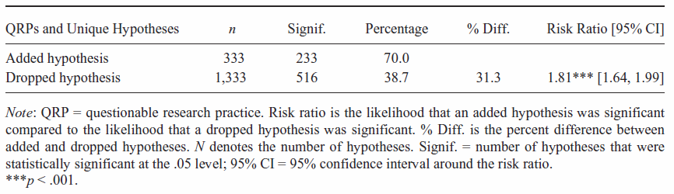
Publication Bias: Outcome-level

Slide 27
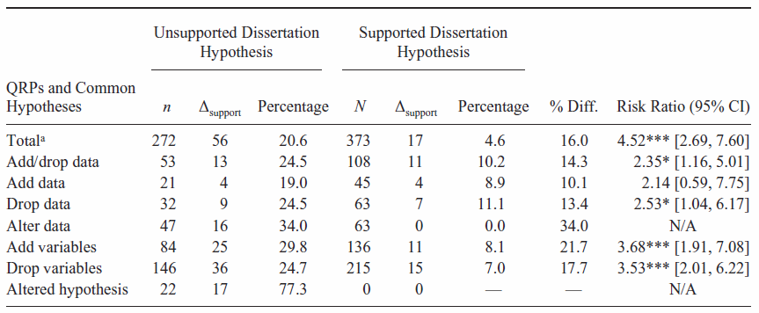
Publication Bias: Outcome-level

Slide 28
Publication Bias: Outcome-level
Organizations that supplies authors the data may requires that some results but not others be dropped.
In employment test validations, organizations may require the authors to drop findings related to adverse impact in hiring decisions.

Slide 29
Sample-level causes of publication bias concern the non-availability of an entire sample.
Sample-level Publication Bias in Primary Studies

Slide 30
Publication Bias: Sample-level
Sources of this bias include author decisions, the editorial review process, and organizational constraints.

Slide 31
Publication Bias: Sample-level
Research in medicine suggests that author decisions are the primary cause of non-publication and thus missing samples (Chalmers & Dickersin, 2013; Dickersin, 1990, 2005).
An author will likely work on the paper that has the best chance of getting into the best journal.
Other papers are abandoned.
Results in small magnitude effects being hidden from the publically available research literature.

Slide 32
Publication Bias: Sample-level
Authors may have personal norms or adopt organizational norms that hold that only articles in top journals “count.”
Count for tenure, promotions, raises, discretionary dollars.
Thus, authors may abandon papers that don’t make the top journal cut.
Results are “lost” to the literature.

Slide 33
Publication Bias: Sample-level
The editorial process will reject:
Poorly framed papers.
Papers without statistically significant findings.
Papers with results contrary to existing literature and current theory.
Well done papers with research that “didn’t work.”

Slide 34
Publication Bias: Sample-level
These editorial decisions result in suppression of effect sizes at the sample-level.
Typically, samples with smaller magnitude effect sizes will be “lost.”
When large effects are socially uncomfortable (e.g., mean demographic differences), the larger effects may be suppressed.

Slide 35
Publication Bias: Sample-level
To clarify, we believe that editors should reject papers that are bad (e.g., bad framing, lack of clear focus, incomplete theory, poorly developed hypotheses, awful measures, poorly designed, inappropriate analysis).
Just don’t define “bad” as:
Small magnitude/non-significant effect sizes
Results inconsistent with hypotheses

Slide 36
Publication Bias: Sample-level
Organizations may not give permission to publish a study if some of the results are not flattering to the organization.
“Glass ceiling” on women

Slide 37
Publication Bias: Sample-level
Some research is asserted to be proprietary.
Try requesting technical documentation from employment test vendors who claim that their employment test has much smaller mean demographic differences than typically observed.

Slide 38
Publication Bias: Sample-level
Neither outcome-level publication bias nor sample-level publication bias results in a “missing data at random” situation.
Not missing at random (NMAR)
There is nothing random about it.
It is systematic!

Slide 39
Is Publication Bias in Our Literature Areas?

Slide 40
Is Publication Bias in Our Literature Areas?
Hypotheses in our journals are almost always supported (e.g., Fanelli, 2010; Sterling & Rosenbaum, 1995).
“Negative” results are disappearing from our published literature (Fanelli, 2012).
Are we approaching omniscience or there are forces at work that cause our journal articles to be unrepresentative of all completed research (Kepes & McDaniel, 2013)?

Slide 41
Is Publication Bias in Our Literature Areas?
Dalton, Aguinis, Dalton, Bosco, and Pierce (2012, p. 222) stated that publication bias “does not produce an inflation bias and does not pose a serious threat to the validity of meta-analytically derived conclusions.”
Vote counting study of the significance and non-significance of correlations.
Took a broad inferential leap.

Slide 42
Is Publication Bias in Our Literature Areas?
Dalton et al. (2012) noted a potentially important limitation of their study:
We have not, however, established this phenomenon at the focal level. Our data do not provide an insight into whether such comparisons would maintain for studies—published and nonpublished—particularly focused on, for example, the Big Five personality traits or employee withdrawal behaviors (e.g., absenteeism, transfers, and turnover). (p. 244)

Slide 43
Is Publication Bias in Our Literature Areas?
When examining at a focal level (a literature on a specific topic), publication bias appears to be relatively common.
Ferguson and Brannick (2012) examined meta-analyses in the psychological literature. Their conclusions:
Publication bias exists in 40% of published meta-analyses
Publication bias was “worrisome” in about 25% of meta-analyses

Slide 44
Is Publication Bias in Our Literature Areas?
OB and HR:
Journal-published mean racial differences in job performance (McDaniel, McKay, & Rothstein, 2006)
Test vendor validity data (McDaniel, Rothstein, Whetzel, 2006; Pollack & McDaniel, 2008)
Journal-published mean racial differences in personality (Tate & McDaniel, 2008)
Judgment and decision making (Renkewitz, Fuchs, & Fiedler, 2011)

Slide 45
Is Publication Bias in Our Literature Areas?
OB and HR …:
Big 5 validity (Kepes, McDaniel, Banks, Hurtz, & Donovan, 2011)
Reactions to training (Kepes, Banks, McDaniel, & Sitzmann, 2012)
Relation between work experience and performance (Kepes, Banks, & Oh, 2014)
Gender differences on transformational leadership (Kepes, Banks, & Oh, 2014)
Pygmalion interventions (Kepes, Banks, & Oh, 2014)

Slide 46
Is Publication Bias in Our Literature Areas?
OB and HR (con’t):
Pygmalion interventions (Kepes, Banks, & Oh, 2014)
Conditional Reasoning Test validity (Banks, Kepes, & McDaniel, 2012)
Strategy and entrepreneurship:
Numerous literature areas in strategy (Harrison et al., 2014) and entrepreneurship (O’Boyle et al., 2013).

Slide 47
Is Publication Bias in Our Literature Areas?
In the next few years, we will likely see more studies examining publication bias.
Conclusion:
There is a considerable and growing body of evidence documenting that publication bias exists in literature areas.
Sometimes, its presence does not meaningfully affect our results.
Sometimes, its presence has resulted in misleading results.

Slide 48
Is Publication Bias in Our Literature Areas?
Publication bias analyses of already completed meta-analyses are relatively easy to do.
Data are sometimes listed in tables. At least, primary studies are listed in the reference section.
Software is readily available.
Although one might hop from one package to another: R, Stata, Comprehensive Meta-analysis (CMA), etc.

Slide 49
Substantially drawn from: Kepes, S., Banks, G.C., McDaniel, M.A., & Whetzel, D.L. (2012). Publication bias in the organizational sciences. Organizational Research Methods, 15, 624-662.
Methods

Slide 50
Fail Safe N
Rosenthal (1979) introduced what he called the “file drawer problem.”
Argument is one of sample-level bias.
His concern was that some non-significant studies may be missing from an analysis (i.e., hidden in a file drawer) and that these studies, if included, would “nullify” the observed effect.

Slide 51
Fail Safe N
Rosenthal suggested that rather than speculate on whether the file drawer problem existed, the actual number of studies that would be required to nullify the effect could be calculated.
Cooper (1979) called this number the fail safe sample size or Fail Safe N.

Slide 52
Fail Safe N
Becker (2005) argued that “Fail Safe N should be abandoned” as a publication bias method.
Different approaches yield widely varying estimates of the Fail Safe N.
Prone to miss-interpretation and misuse.
No statistical criteria available to aid interpretation.

Slide 53
Fail Safe N
More from Becker (2005):
The assumption of a zero effect for the missing studies is likely to be biased (Begg & Berlin, 1988).
The Fail Safe N does not incorporate sample size information (Sutton et al., 2000)

Slide 54
Fail Safe N
Conclusion:
Authors should stop using the Fail Safe N.
Editors and reviewers should stop recommending the use the of the Fail Safe N.

Slide 55
Study Source Comparison
A common study source analysis is to compare published vs. unpublished samples.

Slide 56
Study Source Comparison
One is implicitly making the assumptions that:
The published samples are representative of all published samples.
The unpublished samples are representative of all unpublished samples.
These assumptions are not likely credible (Hopewell et al., 2005)

Slide 57
Study Source Comparison
Consider unpublished samples.
Meta-analyses may oversample from particular sources:
Unpublished samples in meta-analyses are often authored by those who are authors of the meta-analysis (Ferguson & Brannick, 2012).

Slide 58
Study Source Comparison
Encourage searching for unpublished samples and conduct published vs. unpublished moderator analyses.
However, this practice alone is an insufficient approach to assessing publication bias (Kepes et al., 2012).

Slide 59
Symmetry-based Methods
When sampling error is the sole source of variance, and the sampling distribution is symmetrical, then a funnel plot can be examined for symmetry.
A funnel plot is a plot of effect sizes by precision (1/standard error).

Slide 60
Symmetry-based Methods

Slide 61
Symmetry-based Methods
At non-zero population values, the sampling distribution of a correlation is asymmetrical.
Transform correlations into Fisher z.

Slide 62
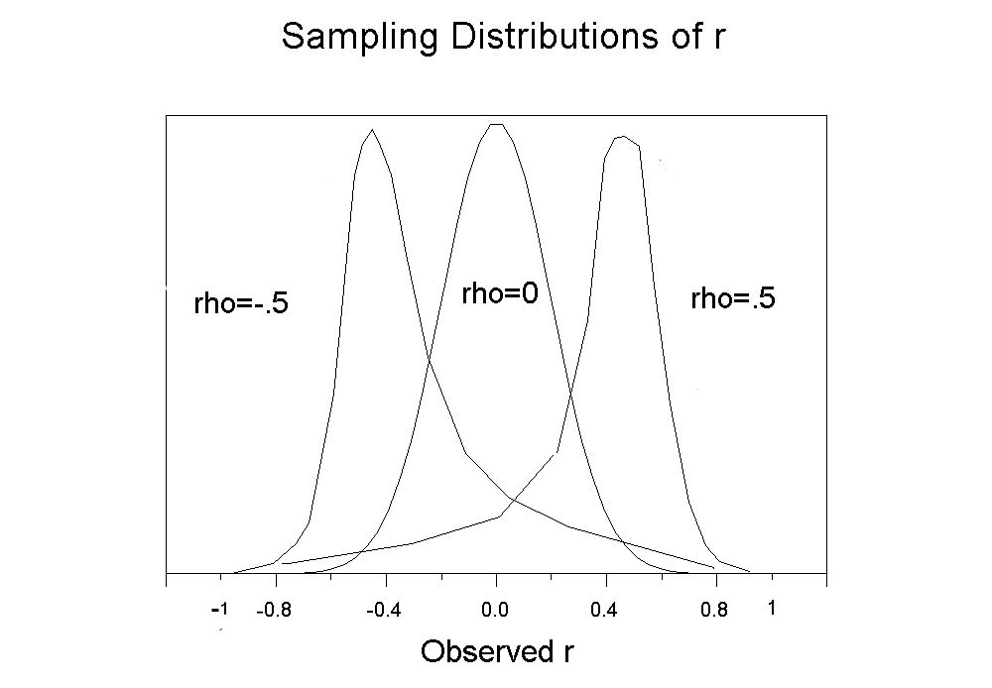
Symmetry-based Methods
Source: http://luna.cas.usf.edu/~mbrannic/ files/regression/corr1.html

Slide 63
Symmetry-based Methods
Asymmetry may be a sign of publication bias.
Asymmetry is likely due to the suppression of statistically non-significant effect sizes from small samples.
Small samples with large magnitude effects, likely statistically significant effects, have a higher probability of being published than small samples with non-significant small magnitude effects.

Slide 64
Symmetry-based Methods
Asymmetrical funnel plot:

Slide 65
Symmetry-based Methods
Asymmetry may be a sign of publication bias.
Asymmetry may also be due to likely suppressed samples that have larger magnitude effect sizes.
The suppression would not be a function of statistical significance.
Larger effects may be suppressed because they are socially uncomfortable.
Mean demographic differences

Slide 66
Symmetry-based Methods
Asymmetrical funnel plot:

Slide 67
Symmetry-based Methods
Sample size (or precision) should not be correlated with effect size.
Begg and Mazumdar’s Rank Correlation Test (Begg & Mazumdar, 1994)
Egger's Test of the Intercept (Egger, Smith, Schneider, & Minder, 1997)
Duval and Tweedie’s Trim and Fill (Duval, 2005)

Slide 68
Symmetry-based Methods
Trim and fill

Slide 69
Symmetry-based Methods
Symmetry methods are not robust to violations of the assumption of sampling error being the sole source of variance (e.g., moderator variance; Terrin et al., 2003).
Our disciplines abound with moderators.
Apply the methods to relatively moderator free subsets of the data.
At least 10 effect sizes (Sterne et al., 2011)

Slide 70
Symmetry-based Methods
The trim and fill method is probably the most useful symmetry based method in that it estimates what the population distribution would be if the missing studies were located.
Analyses are re-conducted on the distribution containing both the observed data and the imputed data.

Slide 71
Symmetry-based Methods
It is unwise to consider this distribution of observed and imputed data as the “true” distribution.

Slide 72
Symmetry-based Methods
More reasonable to compare the observed mean with the trim and fill adjusted mean.
If the mean drops from .45 to .15, one should worry about publication bias.
But, one should not assume that .15 is the best estimate of the population mean.

Slide 73
Symmetry-based Methods
Some asymmetry is not due to publication bias but to “small sample effects.”
A medicine may work best with the sickest (small N) patients and work less well with moderately sick (larger N) patients.
Small sample studies may yield larger effects due to better measures that are more difficult to collect in larger samples.

Slide 74
Symmetry-based Methods
Related to the funnel plot and trim and fill is the contour-enhanced funnel plot, which displays graphically whether the imputed samples are a function of statistical significance (Peters et al., 2008).
Helps separate publication bias effects from “small sample effects.”

Slide 75
Symmetry-based Methods
Contour-enhanced funnel plot

Slide 76
Symmetry-based Methods
Software for symmetry-based analyses:
See Borenstein (2005)
Comprehensive Meta-analysis (CMA) (www.meta-analysis.com)
R (http://www.r-project.org/)
metafor package (www.metafor-project.org)
Stata (see http://www.stata.com/meeting/ 10uk/meta_stata.pdf)
Contour-enhanced funnel plots (the confunnel program; Kepes et al., 2012; Palmer, 2008).

Slide 77
Cumulative Meta-analysis by Precision
Sort samples by sample size or precision.
Conduct a meta-analysis starting with one effect size (the most precise effect) and add an additional effect size (with increasingly less precision) with each iteration of the meta-analysis.
Inspect the meta-analytic means for drift.

Slide 78
Cumulative Meta-analysis by Precision
Banks, Kepes, and Banks (2012) showed some drift consistent with an inference of publication bias for conditional reasoning tests (CRT-A).

Slide 79
Cumulative Meta-analysis by Precision
Example of a CRT-A item:
Wild animals often fight to see who will breed. This ensures that only the strongest animals reproduce. When strong animals reproduce, their young tend to grow into strong and powerful animals. Unlike animals, people who are not strong often reproduce. Which of the following is the most reasonable conclusion based on the above?
People who are not strong can be successful.
People and animals have few similar behaviors.
Unlike most humans, wild animals love to fight.
Humans are becoming physically weaker.
Obtained from http://www.csoonline.com/article/2117477/
employee-protection/preemployment-personality-testing.html

Slide 80
Cumulative Meta-analysis by Precision
N_{cum} Cumulative point estimate (and 95% CI)
The most precise sample (N=542), has an effect size of .06.
With 4 studies needed to bring the N to 1,739, the mean effect size is .05.
With 10 studies needed to bring the N to over 3,000, the mean effect size is .12.
By the time one gets to 48 studies (N = 5,576), the mean effect size is .21.

Slide 81
Cumulative Meta-analysis by Precision
Gives similar results to that obtained in symmetry based methods.
When symmetry analyses suggest small effects are suppressed, cumulative meta-analysis will show a drift toward larger effects.
When symmetry analyses suggest larger effects are suppressed, cumulative meta-analysis will show a drift toward smaller effects.

Slide 82
Cumulative Meta-analysis by Precision
Possibly less affected by moderator induced heterogeneity.
More research is needed.
More research is needed on interpretation heuristics for when to judge a drift as being “meaningful.”

Slide 83
Cumulative Meta-analysis by Year of Publication
Ioannidis has been very active in demonstrating that effect sizes from the earliest published studies typically overestimate population values (e.g., Ioannidis and Trikalinos, 2005).
Proteus phenomenon
(from Greek "πρῶτος" - protos, "first")
Smaller effect size studies appear to take longer to get published.

Slide 84
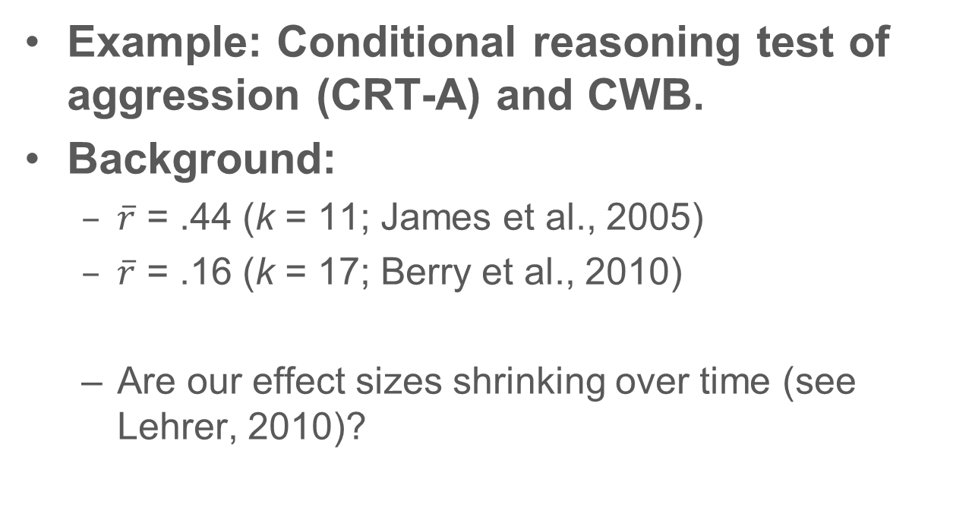
Cumulative Meta-analysis by Year of Publication
Example: Conditional reasoning test of aggression (CRT-A) and CWB.
Background:
$\overline{r}$ = .44 (k = 11; James et al., 2005)
$\overline{r}$ = .16 (k = 17; Berry et al., 2010)
Are our effect sizes shrinking over time (see Lehrer, 2010)?

Slide 85
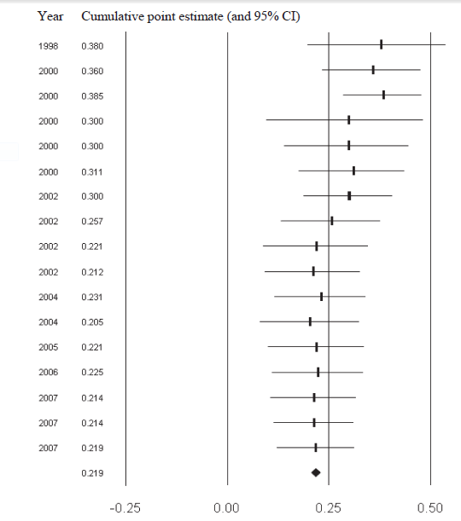
Cumulative Meta-analysis by Year of Publication
Year Cumulative point estimate (and 95% CI)
Cumulative correlation of conditional reasoning test with job performance by year (Banks, Kepes, & McDaniel, 2012)
Earliest studies, on average, show the largest effects.

Slide 86
Cumulative Meta-analysis
Software for cumulative meta-analysis
Comprehensive Meta-analysis (CMA) (www.meta-analysis.com)
Stata (http://www.stata.com/bookstore/meta-analysis-in-stata/; see chapter 1)
Use any software for meta-analysis that supports syntax and use a do loop or similar syntax to add one sample at a time.

Slide 87
Selection Models
Selection models, also called weight-function models, originated in econometrics to estimate missing data at the item level.
Hedges and Vevea introduced the method to the publication bias literature (Hedges, 1992; Vevea & Hedges, 1995).
Relatively robust to heterogeneity (Vevea & Woods, 2005).

Slide 88
Selection Models
As with trim and fill, selection models estimate what the population distribution would be if the missing studies were located and included in the meta-analytic distribution.

Slide 89
Selection Models
When one is conducting a meta-analysis without regard to suppressed studies, one is implicitly assuming that one has 100% of the completed studies.
This assumption is unlikely to be valid (Vevea and Woods, 2005).
Selection models permit you to make other assumptions.

Slide 90
Selection Models
Selection models assume that the probability that an effect size is included in a distribution is a function of a characteristic of that effect size.
This characteristic is usually the level of statistical significance.
Consider an a priori assumed selection model.

Slide 91
Selection Models
An a priori assumed selection model:
Significance level | Probability of being in the distribution
p ≤ .001 | 100%
.001 < p ≤ .05 | 90%
.005 < p ≤ .10 | 70%
p > .10 | 30%

Slide 92
Selection Models
Given an a priori assumed selection model, what would the mean effect be if samples at all statistical significance levels have a 100% probability of inclusion in the distribution?
In practice, one may create several a priori selection model and compare the means to the original meta-analytic mean.

Slide 93
Selection Models
Software for selection models
A priori selection models
R code: Field and Gillett (2010)
S-Plus code: Vevea and Woods (2005)

Slide 94
Excess Significance Findings
Ioannidis and Trikalinos (2007) introduced a test for Excess Significance Findings.
When a group of studies finds statistical significance at a rate much higher than expected based on a power analysis, one may infer that non-significant findings were suppressed or that the data were cooked.

Slide 95
Excess Significant Findings
Example from Francis (in press)
Consider that one has results from five studies (within one article) and each study results in the rejection of the null hypothesis (i.e., has statistical significance).
One might conclude that one has strong support.
To make this inference one needs to consider the statistical power of the studies.

Slide 96
Excess Significant Findings
Statistical power is the probability of rejecting the null hypothesis for a specified effect.
If each of the five studies had a power of .6, the probability of all 5 studies rejecting the null hypothesis is:
.6 * .6 * .6 * .6 * .6 = .078

Slide 97
Excess Significant Findings
This suggests that probability of these five studies (within one article) rejecting the null hypothesis should be rare (.078 times out of 100).
The resulting probability is typically called TES (test of effect sizes) and values below .1 are typically considered non-credible.

Slide 98
Excess Significant Findings
Francis (in press) applied this method to 44 articles with 4 or more experiments in Psychological Science from 2009 to 2012.
82% (36 of 44) of the published articles were judged to contain non-credible findings (TES values less than .1).

Slide 99
Excess Significant Findings
Based on our limited use of this method, one will not reach a conclusion of excess significance when sample sizes are reasonably large and effects are relatively small.
Correlations between conscientiousness and job performance.

Slide 100
Meta-regression
A meta-regression is a regression in which the effect size is the dependent variable and potential moderators are the independent variables.
Egger's Test of the Intercept was noted earlier as a symmetry based method (Egger et al., 1997).

Slide 101
Meta-regression
Egger’s Test examines whether precision is related to the magnitude of an effect size.
Thus, Egger’s Test is conceptually similar to a meta-regression with precision as the single independent variable.
Effect size = a + b₁(precision)

Slide 102
Meta-regression
However, other variables (potential moderator variables) could be included:
Effect size = a + b₁(precision) + b₂(moderator)
Thus, a single regression might be able to simultaneously evaluate moderators and the presence of publication bias.

Slide 103
Meta-regression
Economists are advocates of this approach.
See Doucouliagos and Stanley (2009), Stanley (2008), and Stanley and Doucouliagos (2011).

Slide 104
Meta-regression
Software for meta-regression
SAS, SPSS, and Stata macros (http://mason.gmu.edu/~dwilsonb/ma.html)
Stata (http://www.stata.com/bookstore/meta-analysis-in-stata)
Comprehensive Meta-analysis (CMA) (www.meta-analysis.com)
R metafor package (www.metafor-project.org)

Slide 105
Trim and Fill with Meta-regression
Begin with a meta-regression where independent variables are moderators.
Apply a version of trim and fill to residuals. Impute residuals as needed for symmetry.
Compare original meta-regression to trim and fill meta-regression.
See Weinhandl and Duval (2012)

Slide 106
Prevention of Publication Bias

Slide 107
Prevention of Publication Bias
Extremely thorough literature review (see Rothstein, 2012)
Published
Unpublished
Dissertations
Conference papers
Master’s theses
Foreign language papers
Personal communication with every researcher in the literature

Slide 108
Prevention of Publication Bias
Research registries:
Database where researchers register the studies that they plan to conduct, are in the process of conducting, or have already conducted (Banks & McDaniel, 2011; Berlin & Ghersi, 2005).
Medical sciences (ClinicalTrails.gov)
Education (What Works Clearinghouse; U.S. Department of Education)
Social work (Campbell Collaboration)
Many registries exist in medical research domains.

Slide 109
Prevention of Publication Bias
Changes in the journal review process.
Many medical journals will not accept studies for review unless the study has been pre-registered.
Many medical journals allow for supplemental materials to be offered and made available on the web.
Release data (after some time).
These journal practices should reduce suppression of effect sizes.

Slide 110
Prevention of Publication Bias
Journals could base acceptance/ rejection decisions on the introduction and the method sections of the paper (2-stage review process; see Kepes & McDaniel, 2013)
Reviewers would not see the results and discussion during the first stage of the review process.
Places less reliance on statistical significance as a criterion for acceptance.

Slide 111
Prevention of Publication Bias
The Journal of Business and Psychology now implemented a submission track that uses the 2-stage review process:
Under this submission track, the initial submission includes only the introduction, theory, and method sections.

Slide 112
Prevention of Publication Bias
Alter author and organizational norms concerning the value of publications in less than elite journals.
Stop encouraging the abandonment of research studies when they cannot get into an “A” journal.
Abandonment of research is a very damaging practice for our research literatures.
Many of our “best” universities are promoting the abandonment of research studies.

Slide 113
Prevention of Publication Bias
Alter top journals’ obsession with strong theoretical contributions.
Our discipline has a “theory fetish” (Hambrick, 2007, p. 1346)
“… what we see too often in our journals: a contorted, misshapen, inelegant product, in which an inherently interesting phenomenon has been subjugated by an ill-fitting theoretical framework” (Hambrick, 2007, p. 1349).

Slide 114
Thank you!

Slide 115
References
Aguinis, H., Pierce, C. A., Bosco, F. A., Dalton, D. R., & Dalton, C. M. (2011). Debunking myths and urban legends about meta-analysis. Organizational Research Methods, 14, 306-331. doi: 10.1177/1094428110375720
Banks, G. C., Kepes, S., & Banks, K. P. (2012). Publication bias: The antagonist of meta-analytic reviews and effective policy making. Educational Evaluation and Policy Analysis, 34, 259-277. doi: 10.3102/0162373712446144
Banks, G.C., Kepes, S., & McDaniel, M.A. (2012). Publication bias: A call for improved meta-analytic practice in the organizational sciences. International Journal of Selection and Assessment, 20, 182-196. doi: 10.1111/j.1468-2389.2012.00591.x
Banks, G.C. & McDaniel, M.A. (2011). The kryptonite of evidence-based I-O psychology. Industrial and Organizational Psychology: Perspectives on Science and Practice, 4, 40-44. doi: 10.1111/j.1754-9434.2010.01292.x
Beal, D. J., Corey, D. M., & Dunlap, W. P. (2002). On the bias of Huffcutt and Arthur's (1995) procedure for identifying outliers in the meta-analysis of correlations. Journal of Applied Psychology, 87, 583-589. doi: 10.1037/0021-9010.87.3.583
Becker, B. J. (2005). The failsafe N or file-drawer number. In H. R. Rothstein, A. J. Sutton, & M. Borenstein (Eds.), Publication bias in meta analysis: Prevention, assessment, and adjustments (pp. 111-126). West Sussex, UK: Wiley.

Slide 116
References
Bedeian, A.G., Taylor, S,G. & Miller, A. N. (2010). Management science on the credibility bubble: Cardinal sins and various misdemeanors. Academy of Management Learning & Education, 9, 715–725. doi: 10.5465/amle.2010.56659889
Begg, C. B., & Mazumdar, M. (1994). Operating characteristics of a rank correlation test for publication bias. Biometrics, 50, 1088-1101. doi:10.2307/2533446
Begg, C.B. & Berlin, J.A. (1988). Publication bias: A problem in interpreting medical data. Journal of the Royal Statistical Society. Series A (Statistics in Society), 151, 419-463. doi: 10.2307/2982993
Berlin, J.A. & Ghersi, D. (2005). Preventing publication bias: Registries and prospective meta-analysis. In H. R. Rothstein, A. J. Sutton, & M. Borenstein (Eds.), Publication bias in meta analysis: Prevention, assessment, and adjustments (pp. 35-48). West Sussex, UK: Wiley.
Berry, C. M., Sackett, P. R., & Tobares, V. (2010). A meta-analysis of conditional reasoning tests of aggression. Personnel Psychology, 63, 361-384. doi: 10.1111/j.1744-6570.2010.01173.x
Borenstein, M. (2005). Software for publication bias. In H. R. Rothstein, A. J. Sutton & M. Borenstein (Eds.), Publication bias in meta analysis: Prevention, assessment, and adjustments (pp. 193-220). West Sussex, UK: Wiley.

Slide 117
References
Chalmers, I., & Dickersin, K. (2013). Biased under-reporting of research reflects biased under-submission more than biased editorial rejection. F1000Research, 2, 1-6. doi: 10.12688/f1000research.2-1.v1
Cooper H. M. (1979). Statistically combining independent studies: A meta-analysis of sex differences in conformity research. Journal of Personality and Social Psychology, 37, 131-146. doi: 10.1037/0022-3514.37.1.131
Dalton, D. R., Aguinis, H., Dalton, C. M., Bosco, F. A., & Pierce, C. A. (2012). Revisiting the file drawer problem in meta-analysis: An assessment of published and non-published correlation matrices. Personnel Psychology, 65, 221-249. doi: 10.1111/j.1744-6570.2012.01243.x
Dickersin, K. (1990). The existence of publication bias and risk factors for its occurrence. Journal of the American Medical Association, 263, 1385-1389. doi:10.1001/jama.263.10.1385
Dickersin, K. (2005). Publication bias: Recognizing the problem, understandings its origins and scope, and preventing harm. In H. R. Rothstein, A. J. Sutton, & M. Borenstein (Eds.), Publication bias in meta analysis: Prevention, assessment, and adjustments (pp. 11-34). West Sussex, UK: Wiley.

Slide 118
References
Doucouliagos, H., & Stanley, T. D. (2009). Publication selection bias in minimum-wage research? A metaregression analysis. British Journal of Industrial Relations, 47, 406-428. doi:10.1111/j.1467-8543.2009.00723.x
Duval, S. J. (2005). The ‘‘trim and fill’’ method. In H. R. Rothstein, A. J. Sutton, & M. Borenstein (Eds.), Publication bias in meta-analysis: Prevention, assessment, and adjustments (pp. 127-144). West Sussex, UK: Wiley.
Egger, M., Smith, G. D., Schneider, M., & Minder, C. (1997). Bias in meta-analysis detected by a simple, graphical test. British Medical Journal, 315, 629-634. doi: 10.1136/bmj.315.7109.629
Fanelli, D. (2010). "Positive" results increase down the hierarchy of the sciences. PLoS ONE, 5, e10068. doi: 10.1371/journal.pone.0010068
Fanelli, D. (2012). Negative results are disappearing from most disciplines and countries. Scientometrics, 90, 891-904. doi: 10.1007/s11192-011-0494-7
Ferguson, C. J., & Brannick, M. T. (2012). Publication bias in psychological science: Prevalence, methods for identifying and controlling, and implications for the use of meta-analyses. Psychological Methods, 17, 120–128. doi:10.1037/a0024445

Slide 119
References
Field, A. P., & Gillett, R. (2010). How to do a meta-analysis. British Journal of Mathematical and Statistical Psychology, 63, 665-694. doi: 10.1348/000711010X502733
Francis, G. (in press). The frequency of excess success for articles in Psychological Science. Psychonomic Bulletin and Review. doi: 10.3758/s13423-014-0601-x
Greenhouse, J. B., & Iyengar, S. (2009). Sensitivity analysis and diagnostics. In H. Cooper, L. V. Hedges & J. C. Valentine (Eds.), The handbook of research synthesis and meta-analysis (2nd ed.). (pp. 417-433): New York, NY, US: Russell Sage Foundation.
Hambrick, D.C. (2007). The field of management's devotion to theory: Too much of a good thing? Academy of Management Journal, 50, 1348-1352. doi 10.5465/AMJ.2007.28166119
Harrison, J. S., Banks, G. C., Pollack, J. M., O’Boyle, E. H., & Short, J. (2014). Publication bias in strategic management research. Journal of Management. doi: 10.1177/0149206314535438
Hedges, L. V. (1992). Modeling publication selection effects in meta-analysis. Statistical Science, 7, 246-255. doi:10.1214/ss/1177011364

Slide 120
References
Hopewell, S., Clarke, M., & Mallett, S. (2005). Grey literature and systematic reviews. In H. R. Rothstein, A. J. Sutton, & M. Borenstein (Eds.), Publication bias in meta analysis: Prevention, assessment, and adjustments (pp. 48-72). West Sussex, UK: Wiley.
Ioannidis J. P. A. & Trikalinos T. A. (2005). Early extreme contradictory estimates may appear in published research: the Proteus phenomenon in molecular genetics research and randomized trials. Journal of Clinical Epidemiology, 58, 543-9. doi: 10.1016/j.jclinepi.2004.10.019
Ioannidis J. P. A. & Trikalinos T. A. (2007). An exploratory test for an excess of significant findings. Clinical Trials, 4, 245-253,
James, L. R., McIntyre, M. D., Glisson, C. A., Green, P. D., Patton, T. W., LeBreton, J. M., . . . Williams, L. J. (2005). A conditional reasoning measure for aggression. Organizational Research Methods, 8, 69-99. doi: 10.1177/1094428104272182
Kepes, S., Banks, G. C., McDaniel, M. A., & Sitzmann, T. (2012, August). Assessing the robustness of meta-analytic results and conclusions. Paper presented at the annual meeting of the Academy of Management, Boston, MA.
Kepes, S., Banks, G. C., & Oh, I.-S. (2014). Avoiding bias in publication bias research: The value of "null" findings. Journal of Business and Psychology. doi: 10.1007/s10869-012-9279-0

Slide 121
References
Hopewell, S., Clarke, M., & Mallett, S. (2005). Grey literature and systematic reviews. In H. R. Rothstein, A. J. Sutton, & M. Borenstein (Eds.), Publication bias in meta analysis: Prevention, assessment, and adjustments (pp. 48-72). West Sussex, UK: Wiley.
Ioannidis J. P. A. & Trikalinos T. A. (2005). Early extreme contradictory estimates may appear in published research: the Proteus phenomenon in molecular genetics research and randomized trials. Journal of Clinical Epidemiology, 58, 543-9. doi: 10.1016/j.jclinepi.2004.10.019
Ioannidis J. P. A. & Trikalinos T. A. (2007). An exploratory test for an excess of significant findings. Clinical Trials, 4, 245-253,
James, L. R., McIntyre, M. D., Glisson, C. A., Green, P. D., Patton, T. W., LeBreton, J. M., . . . Williams, L. J. (2005). A conditional reasoning measure for aggression. Organizational Research Methods, 8, 69-99. doi: 10.1177/1094428104272182
Kepes, S., Banks, G. C., McDaniel, M. A., & Sitzmann, T. (2012, August). Assessing the robustness of meta-analytic results and conclusions. Paper presented at the annual meeting of the Academy of Management, Boston, MA.
Kepes, S., Banks, G. C., & Oh, I.-S. (2014). Avoiding bias in publication bias research: The value of "null" findings. Journal of Business and Psychology. doi: 10.1007/s10869-012-9279-0

Slide 122
References
Kepes, Banks, McDaniel, & Whetzel (2012). Publication bias in the organizational sciences. Organizational Research Methods, 15, 624-662. doi: 10.1177/1094428112452760
Kepes, S., & McDaniel, M. A. (2013). How trustworthy is the scientific literature in industrial and organizational psychology? Industrial and Organizational Psychology: Perspectives on Science and Practice, 6, 252-268. doi: 10.1111/iops.12045
Kepes, S., McDaniel, M. A., Brannick, M. T., & Banks, G. C. (2013). Meta-analytic reviews in the organizational sciences: Two meta-analytic schools on the way to MARS (the Meta-analytic Reporting Standards). Journal of Business and Psychology, 28, 123-143. doi: 10.1007/s10869-013-9300-2
Kepes, S., McDaniel, M. A., Banks, C., Hurtz, G., & Donovan, J. (2011, April). Publication bias and the validity of the Big Five. Paper presented at the 26th Annual Conference of the Society for Industrial and Organizational Psychology. Chicago.
Kerr, N. L. (1998). HARKing: Hypothesizing after the results are known. Personality and Social Psychology Review, 2, 196-217. doi: 10.1207/s15327957pspr0203_4
Lehrer, J. (2010). The truth wears off. New Yorker, 86, 52-57.

Slide 123
References
Leung, K. (2011). Presenting post hoc hypotheses as a priori: Ethical and theoretical issues. Management and Organization Review, 7, 471-479. doi: 10.1111/j.1740-8784.2011.00222.x
McDaniel, M. A., Whetzel, D., Schmidt, F. L., Maurer, S. (1994). The validity of the employment interview: A comprehensive review and meta-analysis. Journal of Applied Psychology, 79, 599-616. doi: 10.1037/0021-9010.79.4.599
McDaniel, M. A., McKay, P. & Rothstein, H. (2006, May). Publication bias and racial effects on job performance: The elephant in the room. Paper presented at the 21st Annual Conference of the Society for Industrial and Organizational Psychology. Dallas.
McDaniel, M. A., Rothstein, H. R. & Whetzel, D. L. (2006). Publication bias: A case study of four test vendors. Personnel Psychology, 59, 927-953. doi: 10.1111/j.1744-6570.2006.00059.x
O'Boyle, E. H., Banks, G. C., & Rutherford, M., W. (in press). Publication bias in entrepreneurship research: An examination of dominant relations to performance. Journal of Business Venturing. doi: 10.1016/j.jbusvent.2013.10.001
O’Boyle, E. H., Banks, G. C., & Gonzalez-Mule, E. (in press). The chrysalis effect: How ugly initial results metamorphosize into beautiful articles. Journal of Management. doi: 10.1177/0149206314527133

Slide 124
References
Palmer, T. M., Peters, J. L., Sutton, A. J., & Moreno, S. G. (2008). Contour-enhanced funnel plots for meta-analysis. Stata Journal, 8, 242-254.
Peters, J. L., Sutton, A. J., Jones, D. R., Abrams, K. R., & Rushton, L. (2008). Contour-enhanced meta-analysis funnel plots help distinguish publication bias from other causes of asymmetry. Journal of Clinical Epidemiology, 61, 991-996. doi:10.1016/j.jclinepi.2007.11.010
Pollack, J. M. & McDaniel, M. A. (2008, April). An examination of the PreVisor Employment Inventory for publication bias. Paper presented at the 23rd Annual Conference of the Society for Industrial and Organizational Psychology. San Francisco.
Renkewitz, F., Fuchs, H. M., & Fiedler, S. (2011). Is there evidence of publication biases in JDM research? Judgment and Decision Making, 6, 870-881.
Rosenthal, R. (1979). The file drawer problem and tolerance for null results. Psychological Bulletin, 86, 638-641. doi: 10.1037/0033-2909.86.3.638
Rothstein, H. (2012). Accessing relevant literature. In H. M. Cooper (Ed.), APA handbook of research methods in psychology: Vol. 1. Foundations, planning, measures, and psychometrics (pp. 133-144). Washington, DC: American Psychological Association.

Slide 125
References
Rothstein, H. R., Sutton, A. J., & Borenstein, M. (Eds.). (2005). Publication bias in meta-analysis: Prevention, assessment, and adjustments. West Sussex, UK: Wiley.
Rupp, D.E. (2011). Ethical issues faced by editors and reviewers. Management and Organization Review, 7, 481-493. doi: 10.1111/j.1740-8784.2011.00227.x
Stanley, T. D. (2008). Meta-regression methods for detecting and estimating empirical effect in the presence of publication selection. Oxford Bulletin of Economics and Statistics, 70, 103-127. doi:10. 1111/j.1468-0084.2007.00487.x
Stanley, T. D. and Doucouliagos, H. (2011). Meta-Regression Approximations to Reduce Publication Selection Bias. Manuscript available at www.deakin.edu.au/buslaw/aef/workingpapers/papers/2011_4.pdf
Sterling, T. D., & Rosenbaum, W. L. (1995). Publication decisions revisited: The effect of the outcome of statistical tests on the decision to publish and vice versa. American Statistician, 49, 108-112. doi: 10.1080/00031305.1995.10476125
Sterne, J. A. C., Sutton, A. J., Ioannidis, J. P., Terrin, N., Jones, D. R., Lau, J., . . . Higgins, J. P. (2011). Recommendations for examining and interpreting funnel plot asymmetry in meta-analyses of randomized controlled trials. British Medical Journal, 343, d4002. doi:10.1136/bmj.d4002

Slide 126
References
Sutton, A. J., Abrams, K. R., Jones, D. R., Sheldon, T. A., & Song, F. (2000). Methods for meta-analysis in medical research. West Sussex, UK: Wiley.
Tate, B. W. & McDaniel, M. A. (2008, August). Race differences in personality: an evaluation of moderators and publication bias. Paper presented at the Annual meeting of the Academy of Management, Anaheim CA.
Terrin, N., Schmid, C. H., Lau, J., & Olkin, I. (2003). Adjusting for publication bias in the presence of heterogeneity. Statistics in Medicine, 22, 2113-2126. doi:10.1002/sim.1461
Vevea, J. L., & Hedges, L. V. (1995). A general linear model for estimating effect size in the presence of publication bias. Psychometrika, 60, 419-435. doi:10.1007/BF02294384
Vevea, J. L., & Woods , C.M. (2005). Publication bias in research synthesis: Sensitivity analysis using a priori weight functions. Psychological Methods, 10, 428–443.
Weinhandl, E.D., & Duval, S. (2012). Generalization of trim and fill for application in meta-regression. Research Synthesis Methods, 3, 51-67.

